Slide 1

Expand course6-Musical rhythm
Yahboom
Yahboom OMIBOX Tutorial

Slide 2
1
2
3
4
5
Learning
goals
Search for
blocks
Combine
blocks
Experimental
phenomena
Preparation
程序编程
Tencent
Yahboom OMIBOX Tutorial

Slide 3
1
Preparation-1
1. The position of the LED Matrix and sound module in the robot car
2. Learn how to use LED Matrix and Vioce Sensor return value graphically program building blocks
Yahboom OMIBOX Tutorial

Slide 4
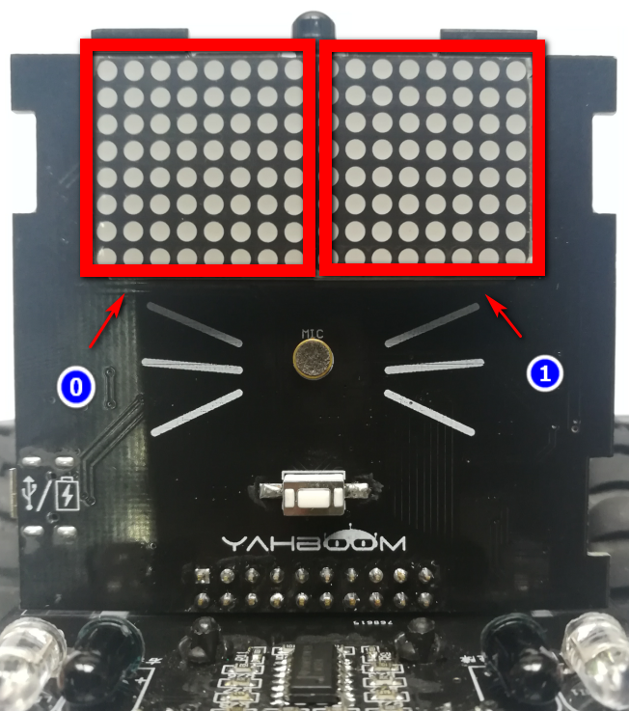
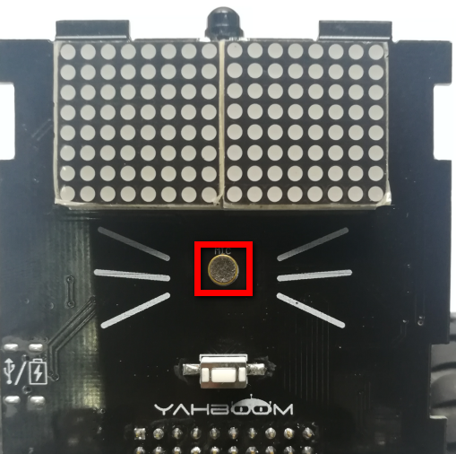
1
Preparation-2
Yahboom OMIBOX Tutorial

Slide 5
2
Learning goals
The phenomenon we need to achieve in this lesson is that, along with the pitch of the music, the Omibox robot will display a strip pattern of different heights on the LED matrix.
Yahboom OMIBOX Tutorial

Slide 6
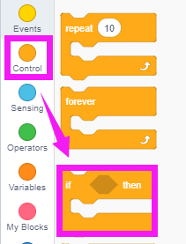
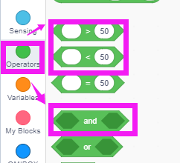
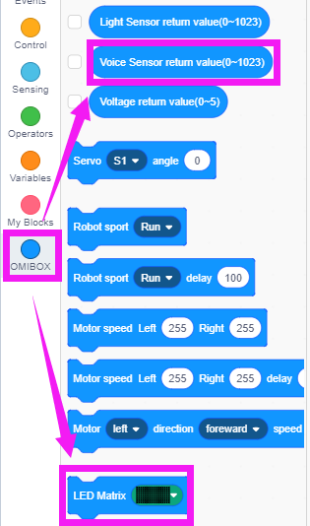
3
Search for blocks
The following is the location of the building blocks required for this programming.
Yahboom OMIBOX Tutorial

Slide 7
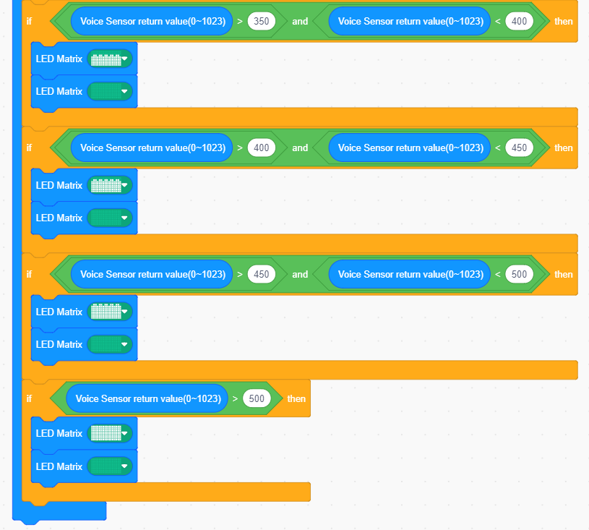
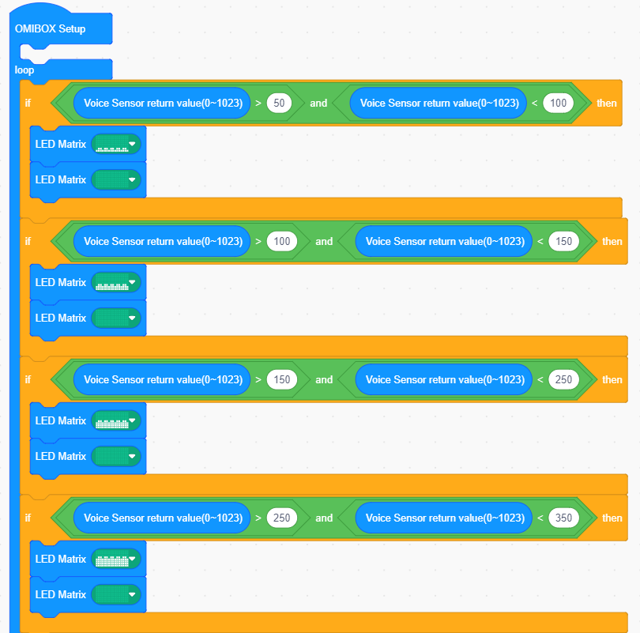
4
Combine blocks
The summary program is shown below:
Yahboom OMIBOX Tutorial

Slide 8
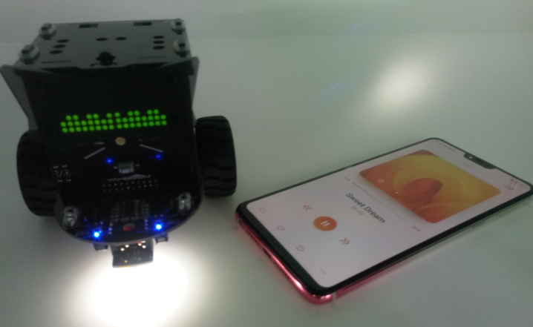
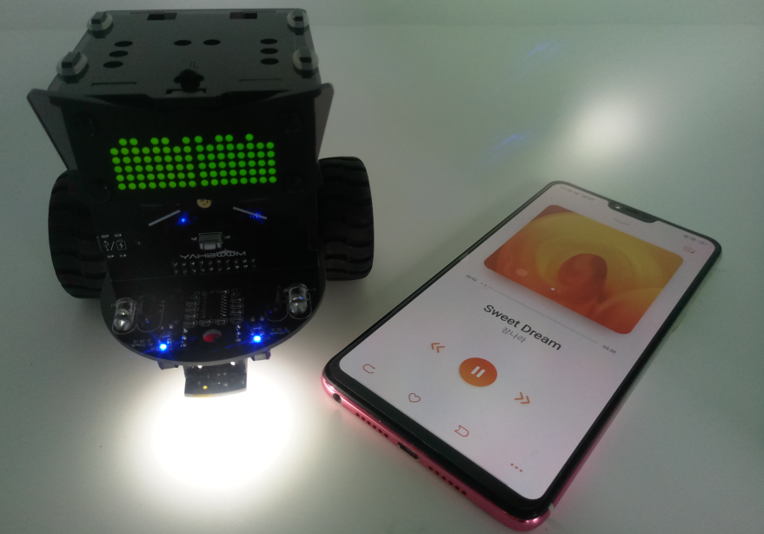

5
Experimental phenomena
After the program is uploaded, open the power of the robot car. Along with the pitch of the music, the Omibox robot will display a strip pattern of different heights on the LED matrix.
In order to reduce the surrounding environment interferes with the sound sensor, so this experiment needs to be carried out in a quiet environment!
Yahboom OMIBOX Tutorial

Slide 9
Inspire Creativity Embrace Innovation
Thank you!!!
Yahboom

